Slide 1

SE Term Project
simple merge
class 01
team 16

Slide 2
Program and Code Explanation – MVC Concept
Controller
MergeController
TextEditorController
Property
Update
Component
Update
Model
View
Merge
FileComparator
TextEditorModel
MainView
PanelView
TextLineNumber
CompareTable
CompareTableRenderer
Property
change
User
Action

Slide 3
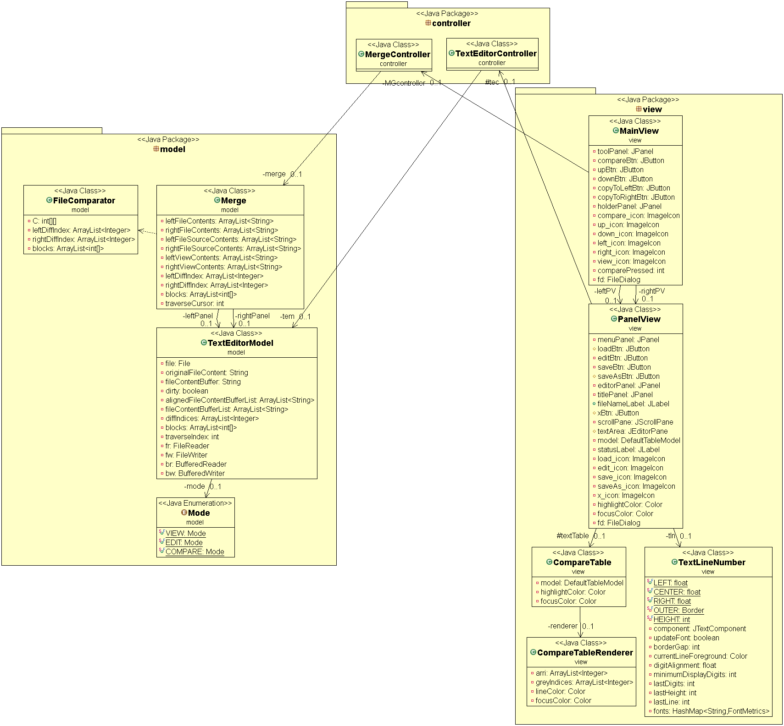
Program and Code Explanation
– Domain Model

Slide 4

Program and Code Explanation – Mode
Compare Mode
View Mode

Slide 5
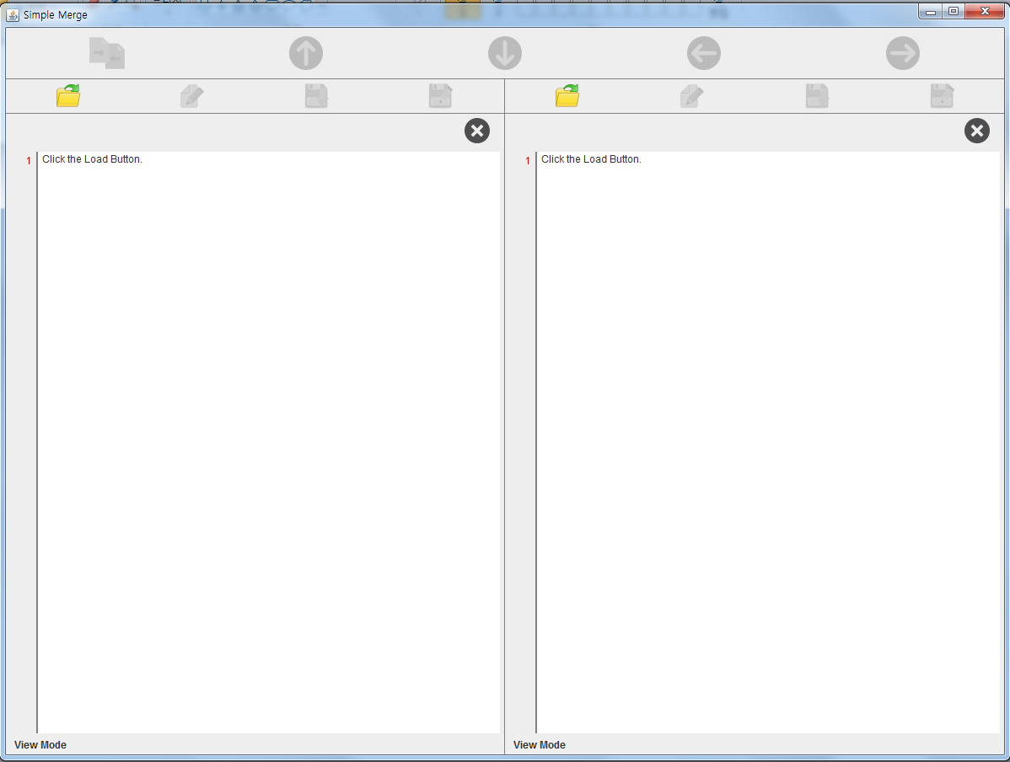
Program and Code Explanation – 시작 화면: Load 버튼 클릭
MainView
다른 패널에 load된 파일과 동일한 파일인지 검사
중복인 경우?
PanelView
TextEditorController
TextEditorModel
Load(string filePath)
Load 버튼만
활성화 상태

Slide 6
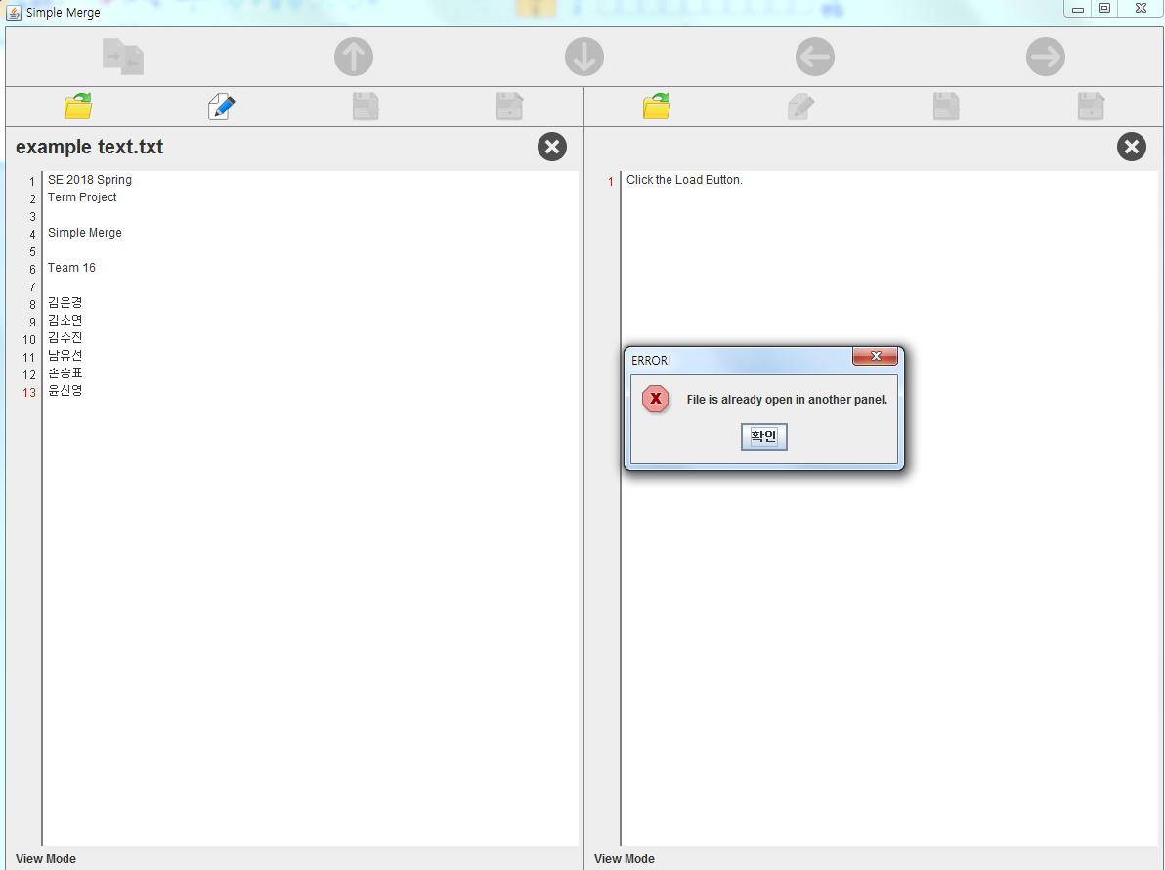
Program and Code Explanation – 중복 파일 Load시
중복임을 알리는
MessageDialog

Slide 7
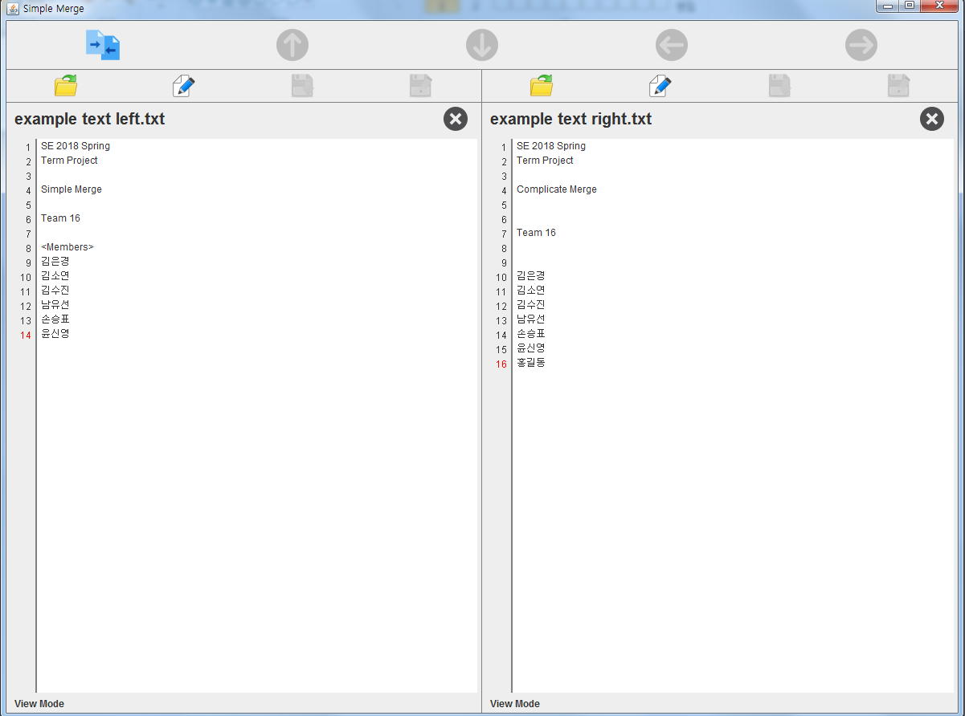
Program and Code Explanation – 파일 Load된 상태(View Mode)
현재 커서가 있는 줄의 index는 빨간색으로 표시됨
현재 패널의 모드 표시
Edit, Compare 버튼 활성화 상태

Slide 8
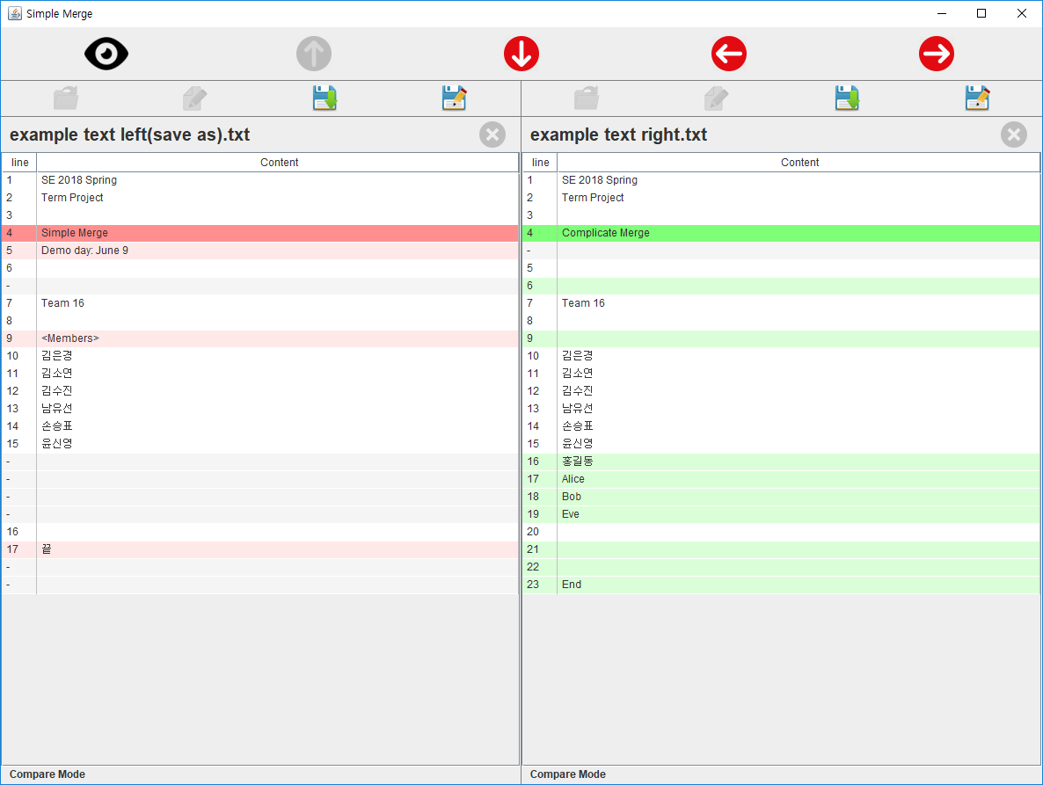
Program and Code Explanation – Compare 버튼 클릭(Compare Mode)
MainView
MergeController
동일한 내용인 경우?
Merge
FileComparator
LCSLength(left panel, right panel); compare(); arrange(); computeBlocks();
Merge
setContentsForView(); Update TextEditorModel Objects
Traverse, Merge 버튼 활성화

Slide 9
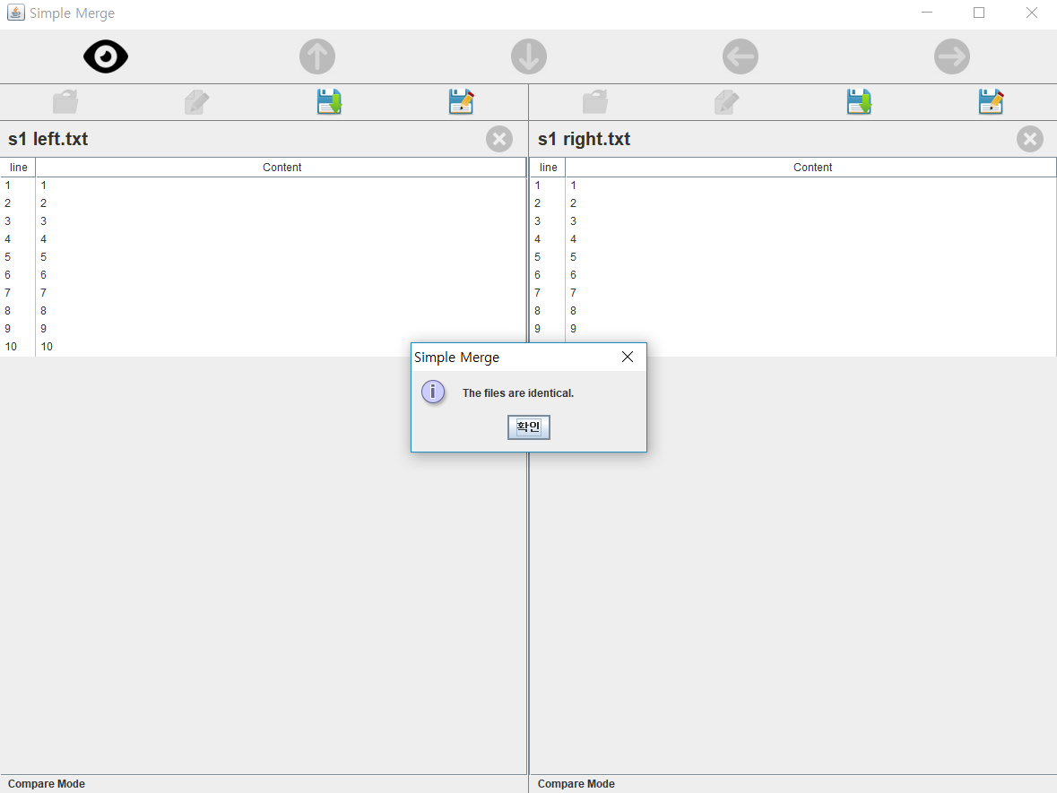
Program and Code Explanation – Compare(동일한 내용인 경우)
동일한 내용임을 알리는
MessageDialog

Slide 10
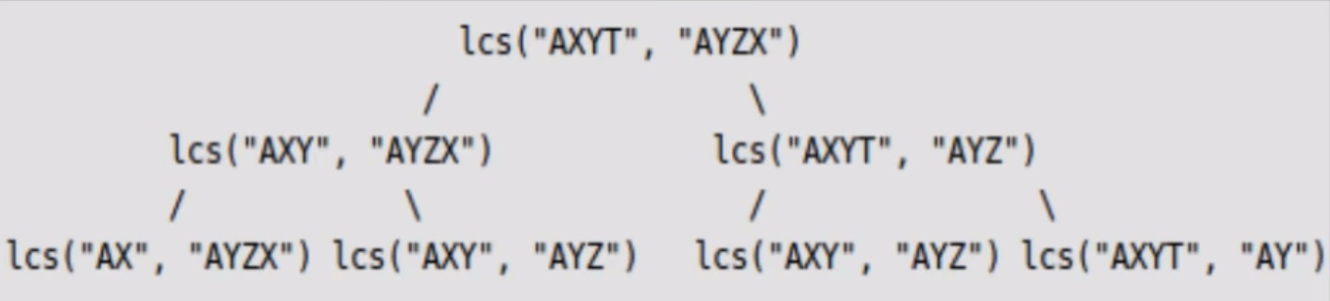
Program and Code Explanation – Compare: LCS
똑같은 연산을 반복하게 되므로 시간이 낭비
따라서 divide&conquer가 아닌 dynamic programming 이용

Slide 11
Program and Code Explanation – Compare Algorithm
1. Longest Common Subsequence 길이 계산
for i := 0..m
C[i, 0] = 0
for j := 0..n
C[0, j] = 0
for i := 1..m
for j := 1..n
if left[i] = right[j]
C[i, j] := C[i-1, j-1] + 1
else
C[i, j] := max(C[i, j-1], C[i-1, j])
return C[m, n]
Left
Right
A
X
Y
Z
C
D
A
B
C
D
E
C = array(0..m, 0..n)

Slide 12
Program and Code Explanation – Compare Algorithm
2. How To Compare
C
i = length of left (6)
R L | 0 | 1 | 2 | 3 | 4 | 5
0
1 |  | 0 | 0 | 0 | 0 | 0
2 |  | 0 | 1 | 1 | 1 | 1
3 |  | 0 | 1 | 1 | 1 | 1
4 |  | 0 | 1 | 1 | 1 | 1
5 |  | 0 | 1 | 2 | 2 | 2
6 |  | 0 | 1 | 2 | 3 | 3
j = length of left (5)
C[i][j] = 3
C[i][j] == C[i - 1][j] ? no
C[i][j] == C[i][j - 1] ? yes
rightDiffIndex.add(0, -1);
j--;

Slide 13
Program and Code Explanation – Compare Algorithm
2. How To Compare
C
i = 6
R L | 0 | 1 | 2 | 3 | 4 | 5
0
1 |  | 0 | 0 | 0 | 0 | 0
2 |  | 0 | 1 | 1 | 1 | 1
3 |  | 0 | 1 | 1 | 1 | 1
4 |  | 0 | 1 | 1 | 1 | 1
5 |  | 0 | 1 | 2 | 2 | 2
6 |  | 0 | 1 | 2 | 3 | 3
j = 4
C[i][j] = 3
C[i][j] == C[i - 1][j ] ? no
C[i][j] == C[i][j - 1] ? no
else
leftDiffIndex.add(0, i);
rightDiffIndex.add(0, j);
i--;
j--;

Slide 14
Program and Code Explanation – Compare Algorithm
2. How To Compare
if
else if
else
C[i][j] == C[i][j - 1]
C[i][j] == C[i – 1][j]
leftDiffIndex.add(0, i);
leftDiffIndex.add(0, -1);
rightDiffIndex.add(0, -1);
rightDiffIndex.add(0, j);
i--;
j--;
i--;
j--;
C[i][j] = 0을 만날 때까지 반복

Slide 15
Program and Code Explanation – Compare Algorithm
2. How To Compare
leftDiffIndex
0 | Not use
1 | 1
2 | -1
3 | -1
4 | -1
5 | 5
6 | 6
rightDiffIndex
0 | Not use
1 | 1
2 | -1
3 | 3
4 | 4
5 | -1
A
X
Y
Z
C
D
A
B
C
D
E

Slide 16
Program and Code Explanation – Compare Algorithm
3. How To Arrange
leftDiffIndex
0 | x
1 | 1
2 | -1
3 | -1
4 | -1
5 | 5
6 | 6
rightDiffIndex
0 | x
1 | 1
2 | -1
3 | 3
4 | 4
5 | -1
L = 1
R = 1
leftDiffIndex[L] != -1 && rightDiffIndex[R] != -1 ? Yes
leftViewIndex.add(L++);
rightDiffIndex.add(R++);

Slide 17
Program and Code Explanation – Compare Algorithm
3. How To Arrange
leftDiffIndex
0 | x
1 | 1
2 | -1
3 | -1
4 | -1
5 | 5
6 | 6
rightDiffIndex
0 | x
1 | 1
2 | -1
3 | 3
4 | 4
5 | -1
L = 2
R = 2
leftDiffIndex[L] != -1 && rightDiffIndex[R] != -1 ? No
leftDiffIndex[L] == -1 && rightDiffIndex[R] == -1 ? Yes
leftViewIndex.add(L * (-1));
rightDiffIndex.add(R * (-1));
L++;
R++;

Slide 18
Program and Code Explanation – Compare Algorithm
3. How To Arrange
leftDiffIndex[L] != -1 && rightDiffIndex[R] != -1 ? No
leftDiffIndex
0 | x
1 | 1
2 | -1
3 | -1
4 | -1
5 | 5
6 | 6
rightDiffIndex
0 | x
1 | 1
2 | -1
3 | 3
4 | 4
5 | -1
leftDiffIndex[L] == -1 && rightDiffIndex[R] == -1 ? No
else
while (rightDiffIndex.get(R) == -1) {
leftViewIndex.add(0);
rightViewIndex.add(R++);
}
while (leftDiffIndex.get(R) == -1) {
leftViewIndex.add(L++);
rightViewIndex.add(0);
}
L = leftDiffIndex.size() 또는 R = rightDiffIndex.size() 될 때까지 반복

Slide 19
Program and Code Explanation – Compare Algorithm
3. How To Arrange
줄 개수가 같아질 때까지 줄 수가 적은 패널에 공백줄을 추가
while (L < leftDiffIndex.size()) {
leftViewIndex.add(L++);
rightViewIndex.add(0);
}
while (R < rightDiffIndex.size()) {
leftViewIndex.add(0);
rightViewIndex.add(R++);
}

Slide 20
Program and Code Explanation – Compare Algorithm
3. How To Arrange
leftViewIndex
0 | x
1 | 1
2 | -2
3 | 3
4 | 4
5 | 5
6 | 6
7 | 0
rightViewIndex
0 | x
1 | 1
2 | -2
3 | 0
4 | 0
5 | 3
6 | 4
7 | 5
A
X
Y
Z
C
D
(공백)
A
B
(공백)
(공백)
C
D
E

Slide 21
Program and Code Explanation – Compare Algorithm
4. Compute Blocks
leftViewIndex
0 | x
1 | 1
2 | -2
3 | 3
4 | 4
5 | 5
6 | 6
7 | 0
rightViewIndex
0 | x
1 | 1
2 | -2
3 | 0
4 | 0
5 | 3
6 | 4
7 | 5
같음

Slide 22
Program and Code Explanation – Compare Algorithm
4. Compute Blocks
leftViewIndex
0 | x
1 | 1
2 | -2
3 | 3
4 | 4
5 | 5
6 | 6
7 | 0
rightViewIndex
0 | x
1 | 1
2 | -2
3 | 0
4 | 0
5 | 3
6 | 4
7 | 5
다름
Block index 추가
(2, 2)

Slide 23
Program and Code Explanation – Compare Algorithm
4. Compute Blocks
leftViewIndex
0 | x
1 | 1
2 | -2
3 | 3
4 | 4
5 | 5
6 | 6
7 | 0
rightViewIndex
0 | x
1 | 1
2 | -2
3 | 0
4 | 0
5 | 3
6 | 4
7 | 5
다름
Block index 추가
(3, 4)

Slide 24
Program and Code Explanation – Compare Algorithm
4. Compute Blocks
leftViewIndex
0 | x
1 | 1
2 | -2
3 | 3
4 | 4
5 | 5
6 | 6
7 | 0
rightViewIndex
0 | x
1 | 1
2 | -2
3 | 0
4 | 0
5 | 3
6 | 4
7 | 5
다름
Block index 추가
(7, 7)

Slide 25
Program and Code Explanation – Compare Algorithm
4. Compute Blocks
0
1
2
3
4
5
6
A
X
Y
Z
C
D
(공백)
A
B
(공백)
(공백)
C
D
E
Block[0] = (2, 2)
Block[1] = (3, 4)
Block[2] = (7, 7)

Slide 26
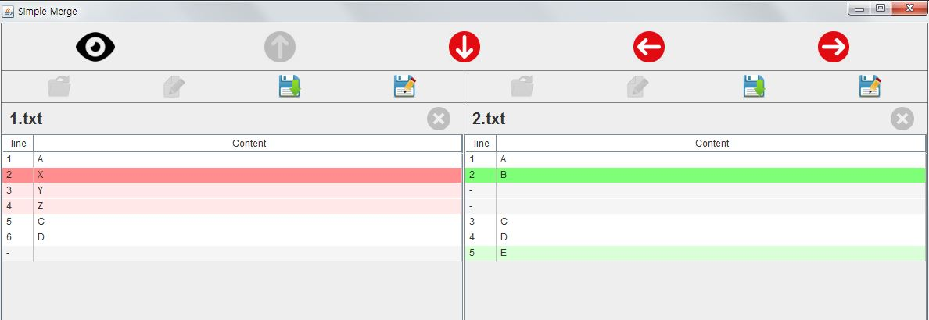
Program and Code Explanation – Compare Algorithm

Slide 27
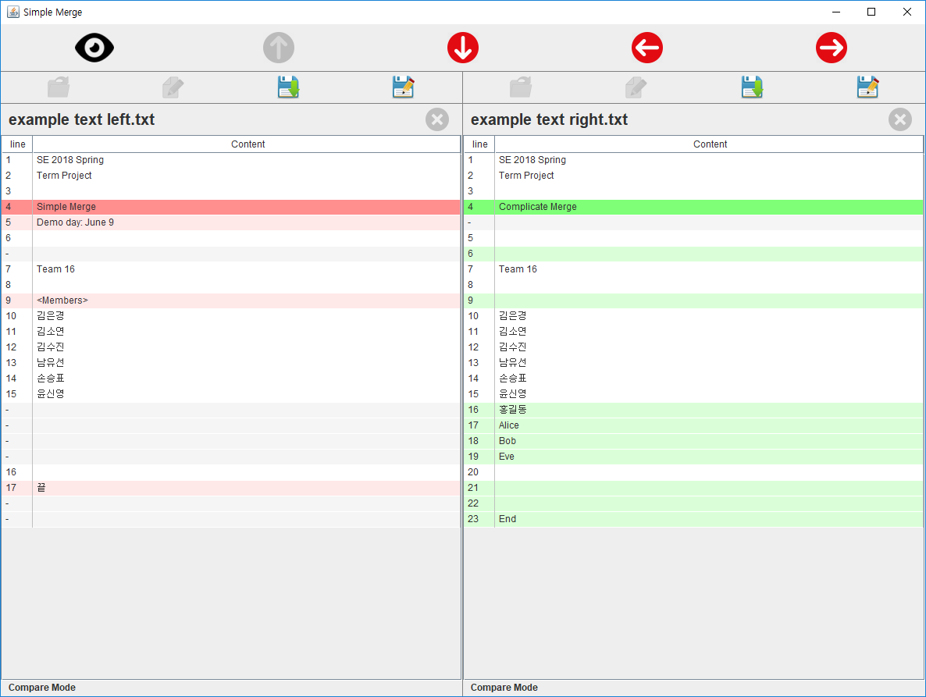
Program and Code Explanation – Compare 결과
줄 정렬을 위해
추가된 공백줄의
Index는 –로
표시
더 이상 traverse 할 수
있는 블록이 없으면
해당 버튼 비활성화
정렬을 위해
추가된 공백 줄은
회색으로 표시

Slide 28
Program and Code Explanation – Merge
MainView
MergeController
callCopyToLeft/Right();
Merge
copyToLeft/Right(); Update TextEditorModel Objects

Slide 29
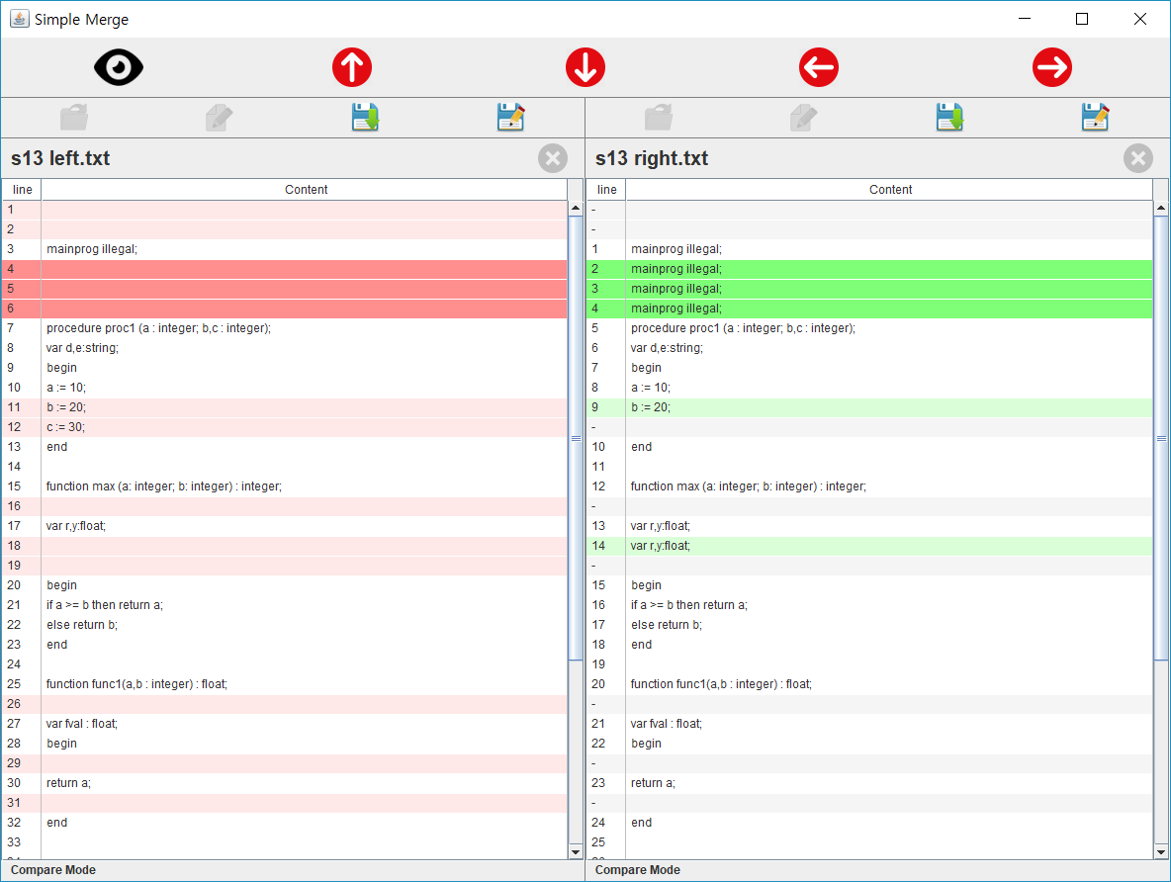
Program and Code Explanation - Traverse
MainView
MergeController
traversePrevious/Next();
Merge
traversePrevious/NextI(); Update TextEditorModel Objects

Slide 30
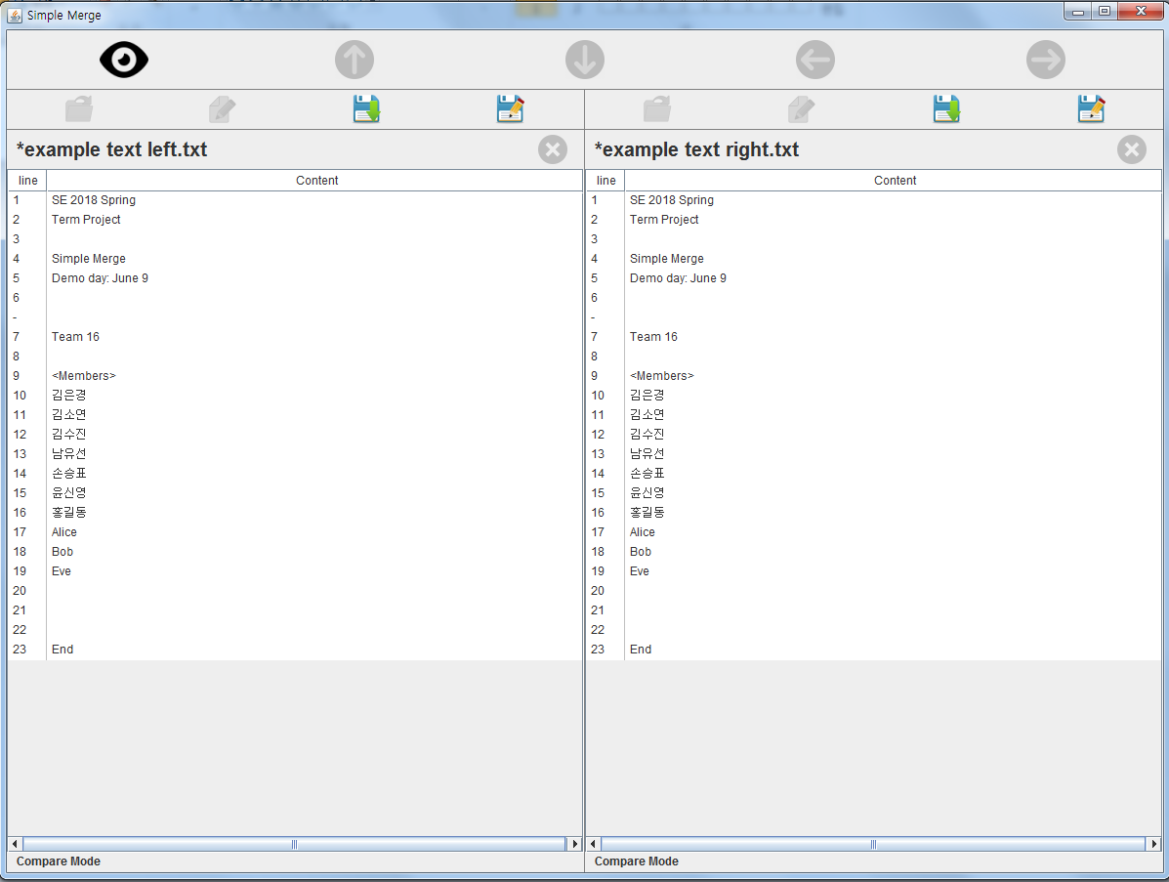
Program and Code Explanation – Merge 이후
수정된 파일의 제목
앞에 * 표시

Slide 31
Program and Code Explanation – Save
PanelView
TextEditorController
TextEditorModel
save();

Slide 32
Program and Code Explanation – Save As
PanelView
TextEditorController
TextEditorModel
saveAs(String FilePath);

Slide 33
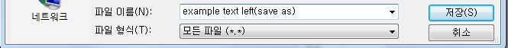
Program and Code Explanation – Save As
Save As로 파일 저장 시,
확장자를 기입하지 않으면 기존 파일의
확장자로 저장하고,
저장 후 해당 패널의 파일은
Save As로 저장한 파일로 교체됨

Slide 34
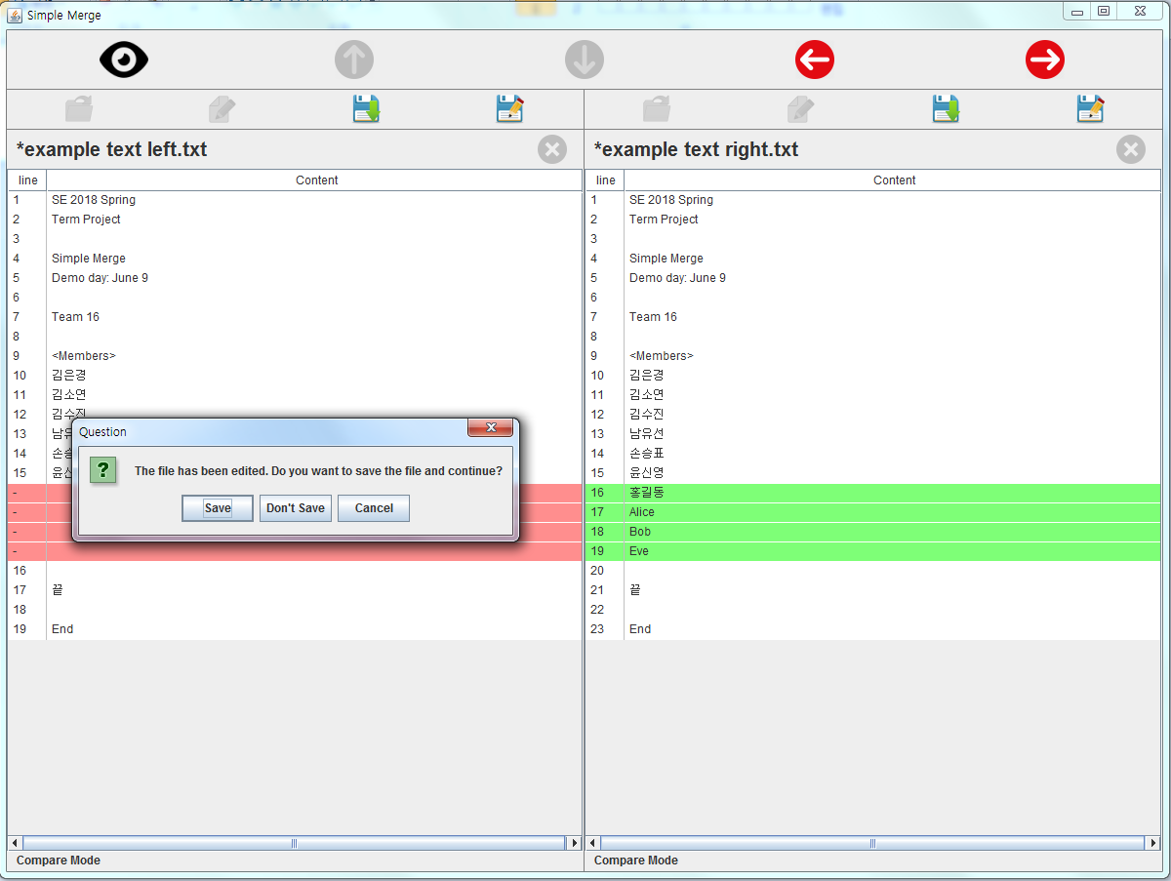
Program and Code Explanation – Compare Mode -> View Mode
저장 여부를 묻는
SaveDialog

Slide 35
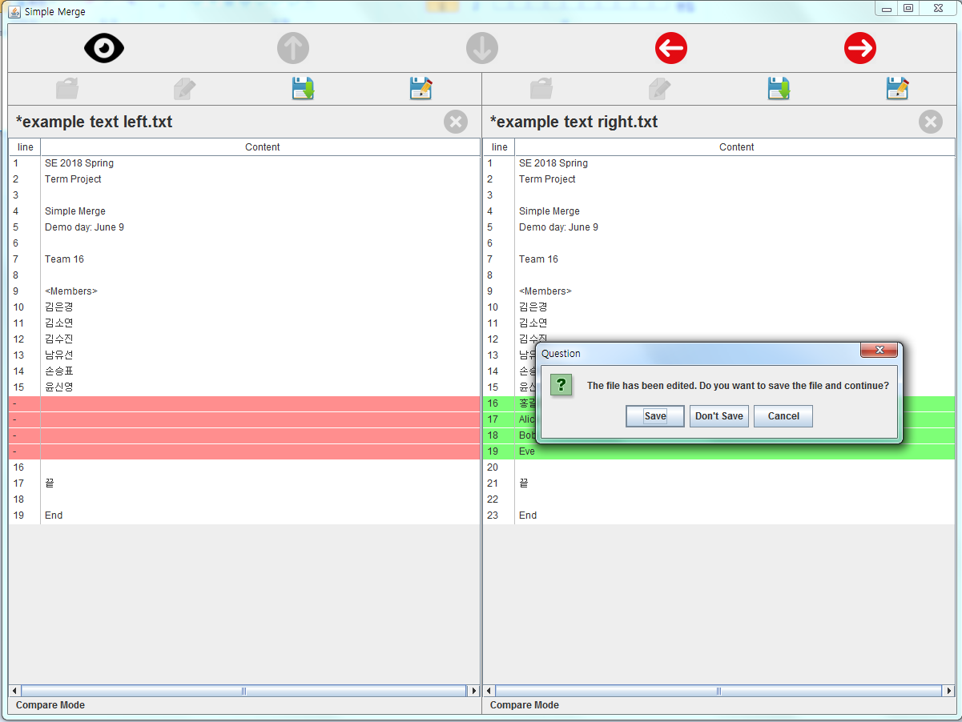
Program and Code Explanation – Compare Mode -> View Mode
저장 여부를 묻는
SaveDialog

Slide 36
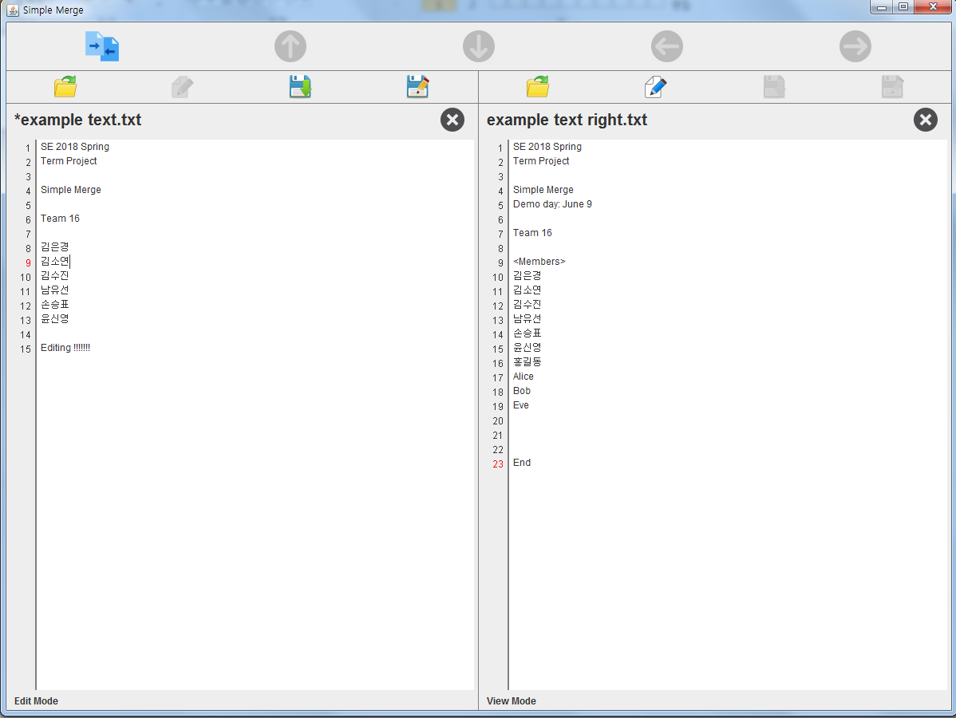
Program and Code Explanation – Edit Mode -> Compare Mode

Slide 37
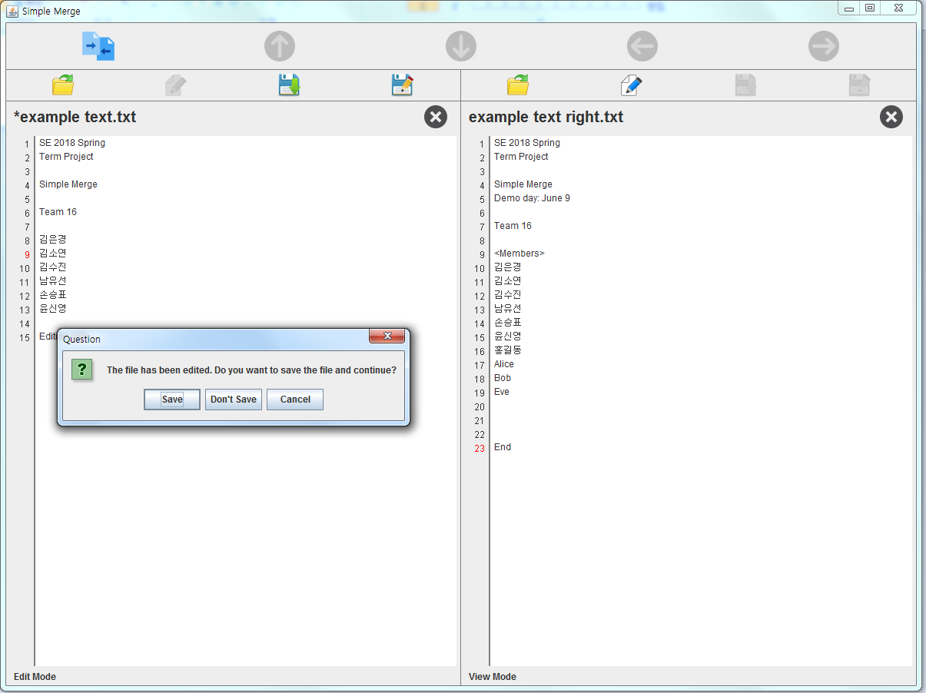
Program and Code Explanation – Edit Mode -> Compare Mode
저장 여부를 묻는
SaveDialog

Slide 38

Team 16
김은경 (20163927)
김소연 (20165417)
김수진 (20160342)
남유선 (20163228)
손승표 (20162581)
윤신영 (20163657)

